Slide 1


Oral Communication Skills B
(CELEN082)
Lesson 6.1

Slide 2
Lesson aims and objectives
Increase awareness of and practise presenting the content typically required in an introduction to an oral presentation. Identify and practise using signposting language used in an introduction. Practise using the beginning of an introduction to ‘grab’ the attention of the audience.

Slide 3

Getting started

Slide 4
Getting started
For homework, you prepared the introduction to your OCSb Final Presentation. With a partner, complete the tasks below:
Present your introduction to each other.
Decide whose introduction was the most effective and explain why.

Slide 5
Introductions
(Content)

Slide 6

Introductions: Content
Watch an experienced speaker present an introduction. Identify the features included and their order.
The speaker … | Order
presents a definition of the problem.
introduces himself to the audience.
states the topic of the presentation.
tries to increase the interest of the audience in the topic.
provides an outline of the specific aspects of the topic he will cover in the presentation.
greets the audience.
X
2
4
3
5
1
Did you include the same features in your introduction?
Did you include anything the speaker didn't? Is it necessary?

Slide 7
Introductions
(Language)

Slide 8
Introductions: Language
Student A and Student B should work together to fill in the spaces in the sample introduction in the OCSb Workbook.
You must follow two rules:
You cannot SHOW each other the script in the OCSb Workbook.
You can only SPEAK to each other.

Slide 9
Introductions: Language
Good afternoon¹. My name is² John Burrows and my presentation today is on³ a problem that, according to a National Health Service study from 2017⁴, contributes to at least one in every thirteen deaths in Europe. Can you guess what I’m going to discuss?⁵ No, it’s not road accidents. No, not smoking. Today, my topic is⁶ obesity. My presentation will focus specifically on tackling the problem of obesity in the United Kingdom and will be divided into⁷ two parts. First, I’ll explain⁸ the problem. Then, I’ll focus on⁹ two solutions and evaluate their effectiveness¹⁰. These solutions are¹¹ a ban on the advertising of sugar-sweetened drinks and increasing the amount of physical activity in daily life through government supported campaigns in local communities.

Slide 10
Introductions: Language
Match the underlined language and language from the gaps to the appropriate function in the table.
 | FUNCTION | Language (1-11)
A | Presenting the overview of the presentation | (7) will be divided into (8) First, I’ll explain (9) Then, I’ll focus on | (10) evaluate their effectiveness (11) These solutions are
B | Introducing surprising statistics (‘grab’ attention) | (4) according to a National Health Service study from 2017
C | Greeting the audience | (1) Good afternoon
D | Stating the topic | (6) Today, my topic is
E | Rhetorical question (‘grab’ attention) | (5) Can you guess what I’m going to discuss?
F | Introducing yourself | (2) My name is
G | Starting the presentation | (3) my presentation today is on

Slide 11
Introductions: Language
Analyse the overview of the introduction more closely. Underline the most commonly used verb tense.
My presentation will focus specifically on tackling the problem of obesity in the United Kingdom and will be divided into two parts. First, I’ll explain the problem. Then, I’ll focus on two solutions and evaluate their effectiveness. These solutions are a ban on the advertising of sugar-sweetened drinks and increasing the amount of physical activity in daily life through government supported campaigns in local communities.
Think of one reason why the speaker chose to use ‘will’ .
‘Will’ is commonly used for making promises.
You are promising your audience that you’ll cover these points.

Slide 12
‘Grabbing’ your audience’s attention

Slide 13
‘Grabbing’ your audience’s attention: Methods
How did the experienced presenter try to ‘grab’ your attention?
Think of other methods presenters can use to ‘grab’ your attention.
 | Sample introduction
Introduce the attention grabber
Picture
Surprising statistics / news
Story
Rhetorical question
Real question
Instruction to audience
Comment on audience response
Link to presentation topic
√
√
√
√
√

Slide 14
‘Grabbing’ your audience’s attention: Practice
Your tutor will divide you into A and B.
Complete the tasks below:
Read your assigned attention grabber and identify the methods used to grab the audience’s attention.
Practise presenting your assigned attention grabber. The stress and suggested pausing is marked out for you.
Students A
Work in pairs focusing on
Attention Grabber A.
Students B
Work in pairs focusing on
Attention Grabber B.

Slide 15
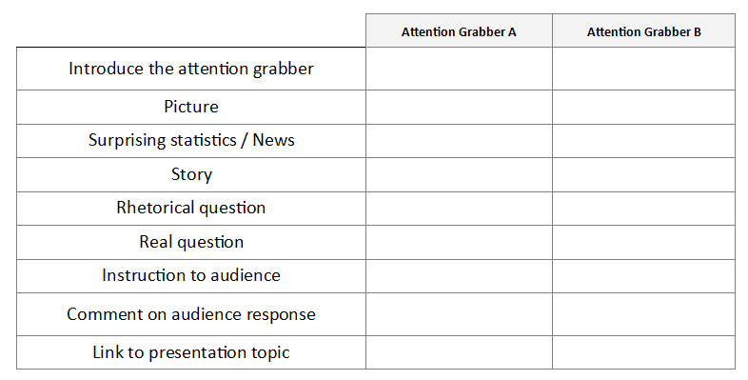
‘Grabbing’ your audience’s attention: Practice
Form a new pair:
One student A and one student B should work together.
Present your attention grabber to each other. When your partner is presenting, listen and complete the table in the OCSb Workbook.
Identify the methods used to grab the audience’s attention.
Check your answers with your partner.
When you have finished, discuss which attention grabber you prefer and justify your choice.
Don’t show your partner your attention grabber script. You must LISTEN to each other.
The picture for Attention Grabber A is on the next slide.

Slide 16

Attention Grabber A (picture)
Notes:
https://glamourfame.com/uploads/biography/2021/12/6/1%20(1)-1638795545306.jpg

Slide 17
‘Grabbing’ your audience’s attention: Practice
 | Attention grabber A | Attention grabber B
Introduce the attention grabber
Picture
Surprising statistics / news
Story
Rhetorical question
Real question
Instruction to audience
Comment on audience response
Link to presentation topic
√
√
√
√
√
√
√
Which attention grabber do you prefer? Why?
√
√
√

Slide 18
‘Grabbing’ your audience’s attention: Language
Analyse both attention grabbers and find the language that the presenter uses to perform the functions from the Useful Language for… column.
Attention Grabber A Good morning. My name is ______. Before we get started, I’d like to show you a picture [POINT TO THE PICTURE]. This is actress Rebel Wilson before and after her weight loss. For years she struggled with health problems due to obesity, but she is now healthier and happier. The struggles that Rebel Wilson faced are becoming increasingly common across the developed world. And this leads me to the topic of my presentation, as, today, I will discuss how to tackle the issue of obesity in the UK. | Useful language for … introducing the attention grabber linking to the presentation topic

Slide 19
‘Grabbing’ your audience’s attention: Language
Analyse both attention grabbers and find the language that the presenter uses to perform the functions from the Useful Language for… column.
Attention Grabber B Good morning everyone. My name is _____ . Before I begin my presentation, I’d like to ask you a question. How many of you here have consumed too much sugar or not done enough exercise this week? Please raise your hand if your answer is yes [LONG PAUSE]. That’s interesting because almost everybody has raised their hand. Well, did you know that excess sugar consumption and lack of exercise are major contributors to rising obesity rates in many developed countries? And that leads us nicely to the topic of my presentation. | Useful language for … introducing the attention grabber instructing the audience commenting on the audience response linking to the presentation topic

Slide 20
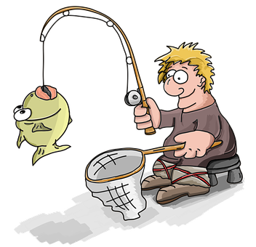
Introductions: Attention grabber
The aim of an attention grabber is to ‘grab’ the audience’s attention. It is also known as a ‘hook’.
In the Final Presentation, you will be assessed on the effectiveness of your attention grabber.

Slide 21
PowerPoint slides for the introduction

Slide 22
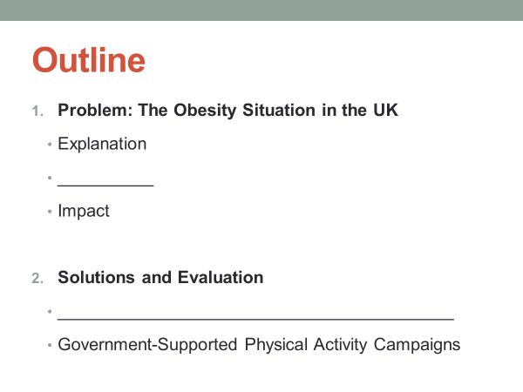

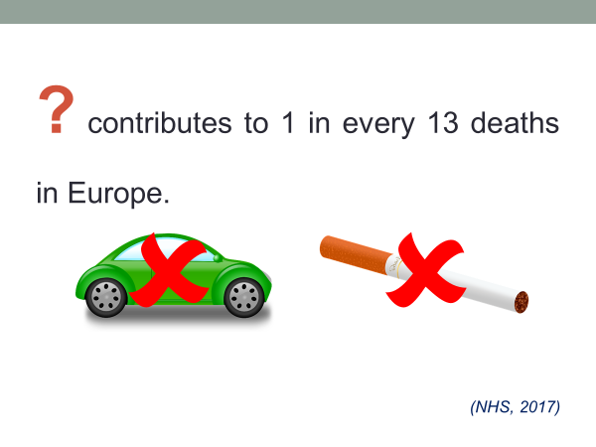
PowerPoint slides for the introduction
Look at the three PowerPoint slides from the experienced presenter’s introduction on Obesity in the UK, and put them in the order in which they appeared.
3
2
1

Slide 23
PowerPoint slides for the introduction
Fill in the missing spaces in the overview/ outline slide.
Identify:
at least one method used to present content effectively on the overview/outline slide.
at least one method to present the text effectively.
The problem is clearly identified on the slide
Consistent use of simple grammar.
All items written as noun phrases.
The sub-sections of the ‘problem section’ are listed
Causes
The two solutions are listed
Consistent use of capital letters.
Sugar-Sweetened Drink Advertising Ban
Use of bold font to distinguish between main section titles and supporting points.

Slide 24
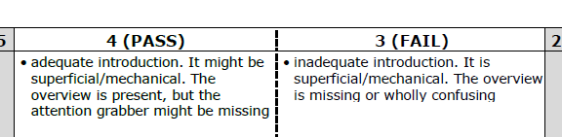
Introductions: Outline/overview
Providing an overview of your presentation helps the audience prepare for the content of your presentation. Therefore, it is a key element of the introduction.
The overview should consist of the headings of the different sections you will present. To help guide the audience through your presentation, the headings for the different sections should match the overview.
In the Final Presentation, you must include an overview in your introduction, or you will fail in the Task achievement criteria.

Slide 25
Independent practice

Slide 26
Practice
Review the introduction that you prepared for homework and complete the following tasks:
Make improvements to your introduction e.g. add missing content, improve your signposting etc.
Present your introduction to a partner. Your partner will video record you.
Watch your video. Are you happy with your introduction?

Slide 27
Homework
Due | Task
Lesson 7.2 | Prepare the conclusion of your OCSb Presentation. Decide what you will say.​ Practise saying it.​ Create at least one PowerPoint slide for your conclusion.​ Bring your slide and script (if you write one) to class.

